Slide 1
Smart Waste Management System Using IBM Watson Services
Can Your Dustbin Be Smart?
Guided by:-
Presented By :- sandeep doodigani
Suamsai

Slide 2
What Is Smart Waste Management?
The smart system devised by major IT companies and the IoT combined offer many advanced technology functions which have perfected the waste management solutions. The smart system is capable of analyzing a situation through data and sensors to control and sort through predictive data the most efficient way of managing waste
1. Reduce the amount of time and energy required to provide waste management services.
2. Reduce the amount of waste created.

Slide 3
Introduction
Literature Survey.
Existing System
Proposed System
System Architecture
System Components
System Design
Implementation
Advantages and disadvantage
Application
Future Scope
Conclusion
References

Slide 4
Introduction
provides an IOT based solution to garbage collection
This checks the waste level over the dustbins by using Sensor.
Once it detected immediately this system alert to concern authorized through IBM Watson Services.
An android application is developed for the desired information
This is ensued the greenish in the environment and support for Swachh Bharat for cleanness.

Slide 5
Literature Survey
5
Sr no | Name of paper | Author | Existing System | Published | Elements
 |  |  |  | 2017 | IOT module is used to
 | Automatio | Bharadwaj B, |  |  | control waste &data will
3 | n of smart | M Kumudha, | IEEE |  | be sent to the
 | waste | Gowri |  |  | Organization& common
 | management | Chandra N, |  |  | man.
 |  | Chaithra G
 | Dustbins | Bikramjit |  | 2016 | This system to garbage
4 | for Smart | Singh, | IJCSIT |  | collection providing
 | Cities | Manpreet |  |  | greater accessibility
 |  | Kaur |  |  | ,planning proper for
 |  |  |  |  | disposing process.

Slide 6
Existing System
A waste-bin system can be adapted into general waste-bin and it consists of the sensing units, a Bluetooth and GSM Module for data transmission, and a mobile application and web-based monitoring for interfacing and communication with the waste department for waste management.
The smart bin is composed of sensor node mounted on it for the data collection and transmission. The sensors are divided into two path. One path is mounted with the bin cover and the other is in the bottom of the bin. The first path is level sensor to monitoring the level of waste-bin. The other path is smart load cell sensor to calculate the weight of waste.

Slide 7
Proposed System
Real time waste management system to check the fill level of dustbins whether the dustbins are full or not.
It will inform the status of each and every dustbin so that concerned authority can send the garbage collection vehicle
The level of waste in the dustbins is detected with the help of Ultrasonic sensor.
When the measured value of sensors exceeds a certain threshold value then red led becomes ON.
Android device will detects, in which area dustbin is located and status of that.

Slide 8
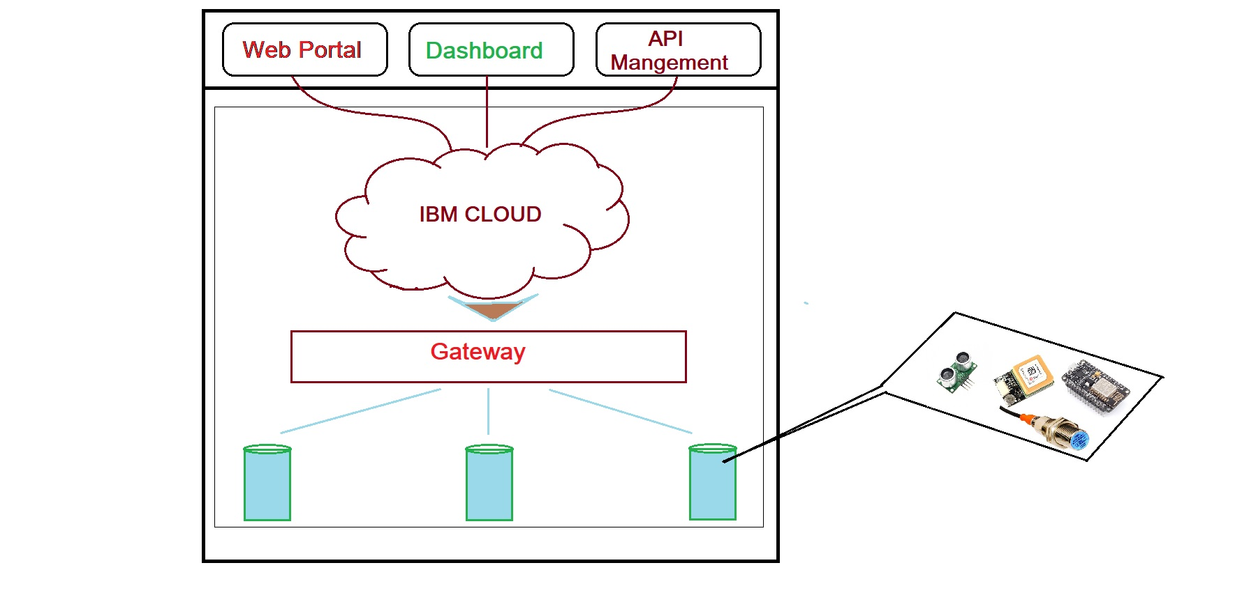
System Architecture

Slide 9
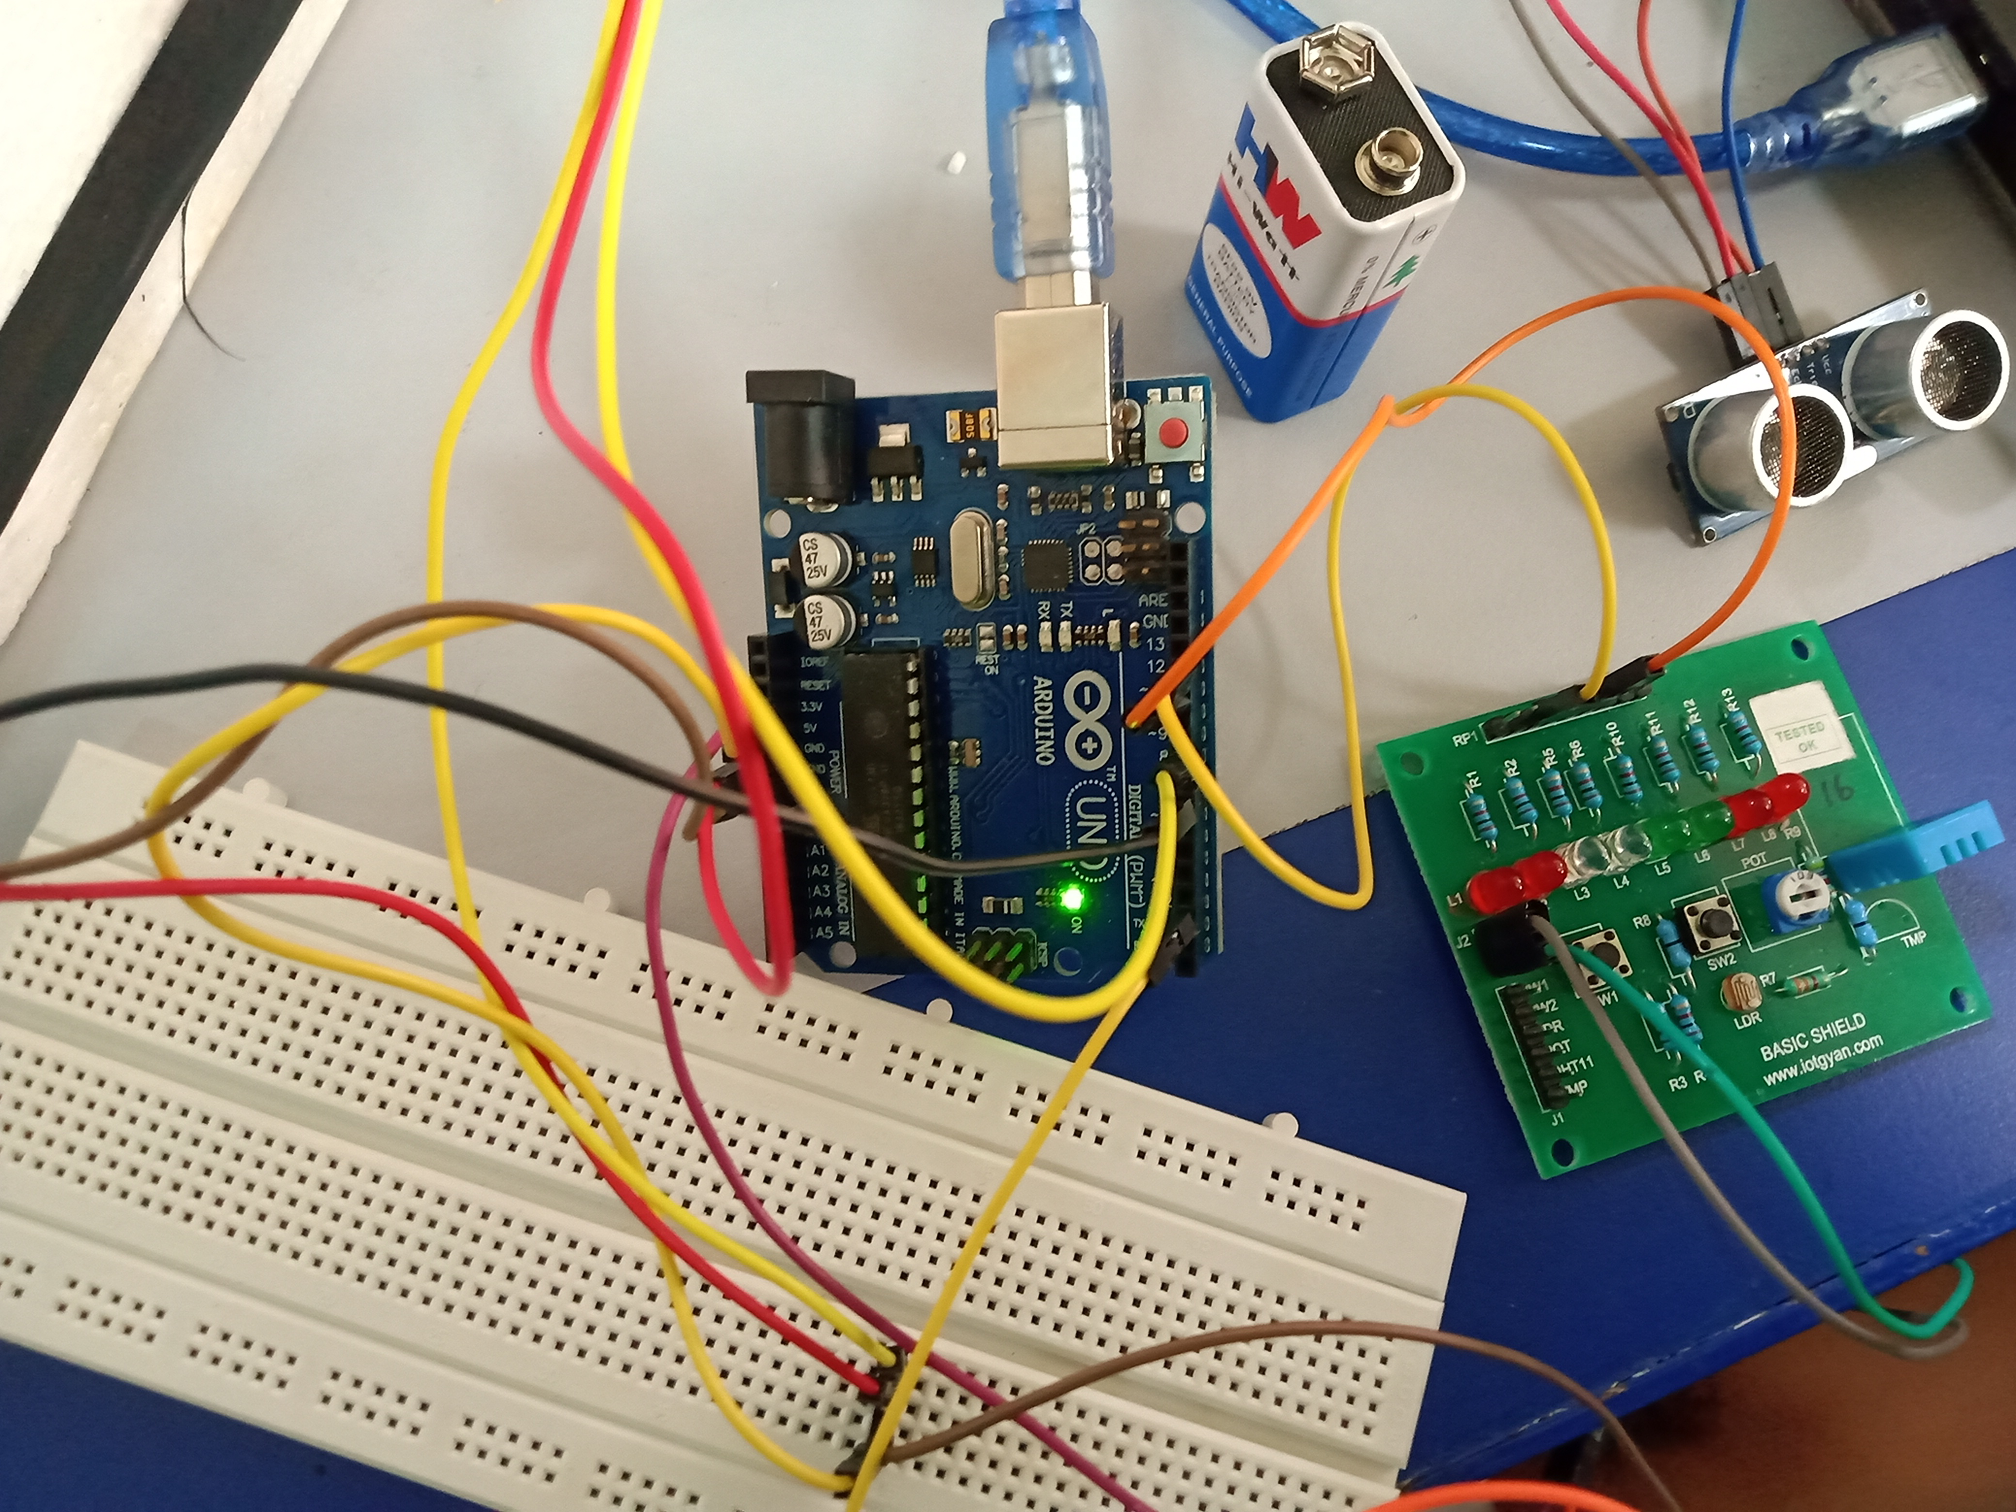
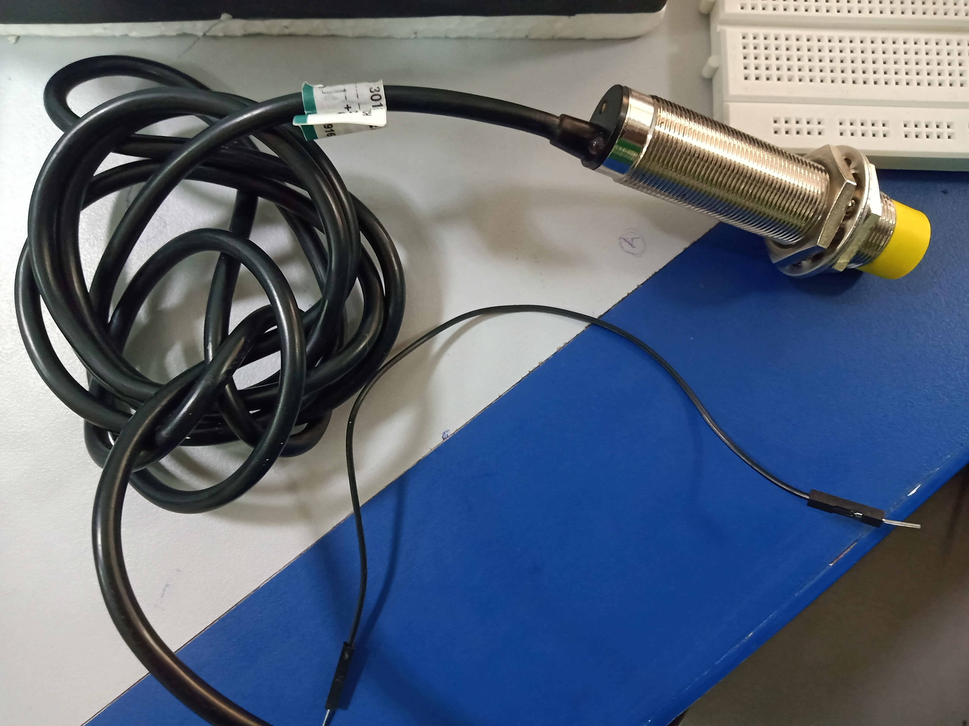
System Components
Arduino UNO
9v.Battery
Ultrasonic sensor
Breadboard
NODE MCU
Basic Shield
Jumper Wires

Slide 10
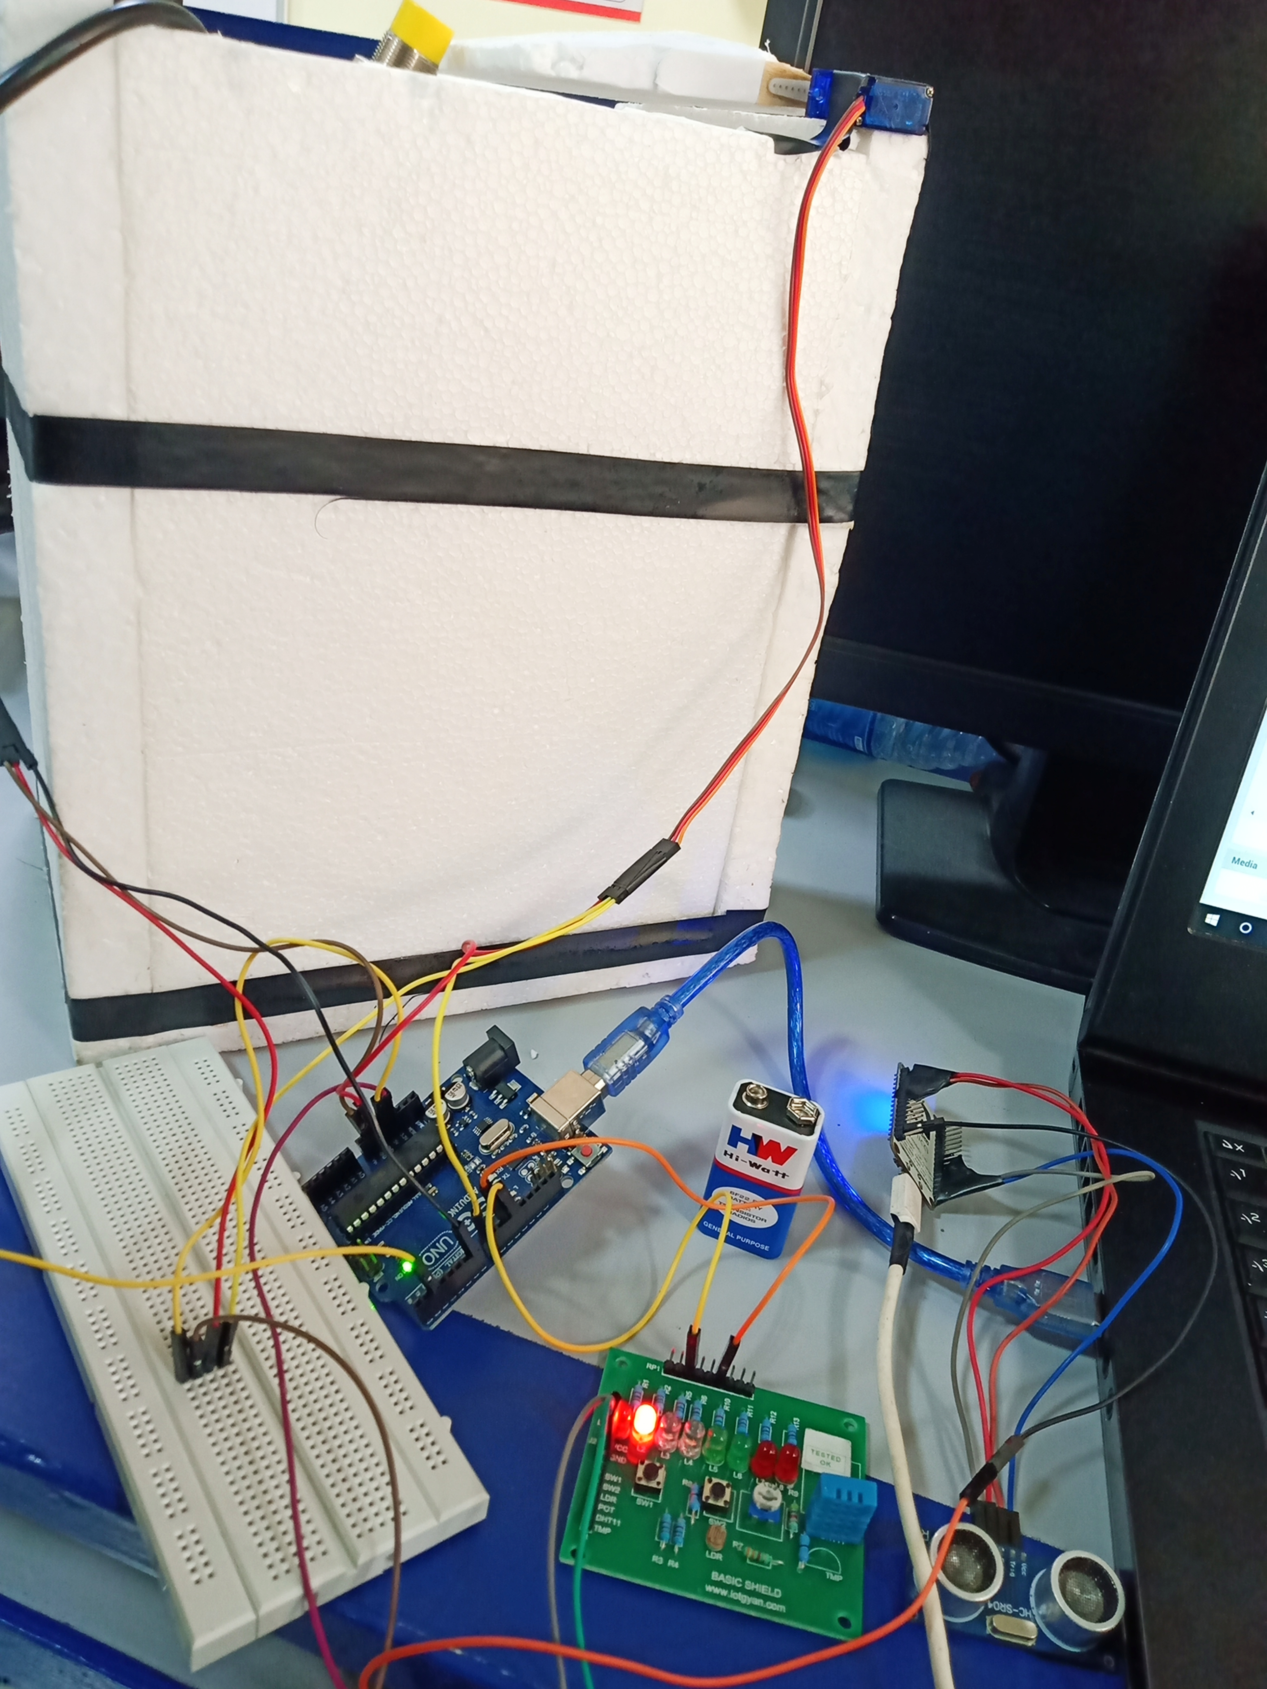
System Design

Slide 11
Advantages
Our system provides greater accessibility to the dustbin.
In our system if dustbin is relocated to another location it will automatically registered with the server with the new GPS location.
It will save fuel and time using appropriate route planning.
This practice is highly lucrative
Keeps the environment clean and fresh
Reduces environmental pollution

Slide 12

Application
Empowered Swach Bharat Mission.
e-Governance Based on Digital India.
Reduce environmental pollution.
Real time based cleaning of our cities.
It makes our system transparent between Municipal Corporation, Workers and public.

Slide 13
Future Scope
It can be made durable, by making it compact and cost Effective
This prototype is made for demo concern, it can be taken to product level
Two bins can be placed to collect wet and dry waste separately.
Wet waste can be decomposed and used for making biogas.

Slide 14

Thank You

